Slide 1
Web Development Credential – Week 1
Josh Kohn
Danny Laurence

Slide 2
Introductions
(Me, you)

Slide 3
Expectations

Slide 4
Expectations
Students
Instructors
Show up to at least 3 of 4 classes (or miss small portions of multiple classes)
Be willing to stretch the learning boundary
Work on your project outside of class
Set up all tools you need to succeed in the course
Respond to Emails quickly and accurately
Breakfast and lunch at every class

Slide 5
How does the Web work?

Slide 6
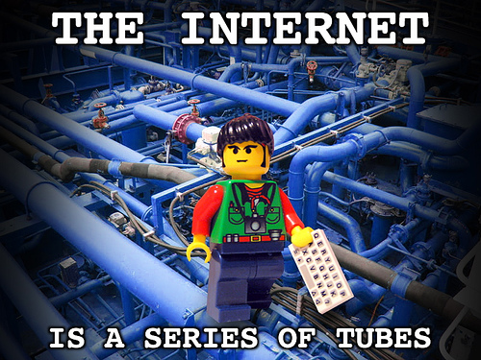

What’s the difference?
Internet
The Web
Vint Cerf
Invented in the 1970s
Simply a way to connect two computers
Tim Burners-Lee
Invented in 1991
Used to quickly share documents

Slide 7
What happens when You Go to Danny’s FB profile?
Your Browser
Internet
Facebook.com

Slide 8
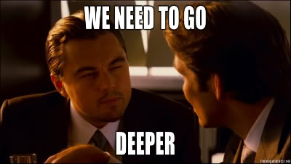
Just Kidding!

Slide 9
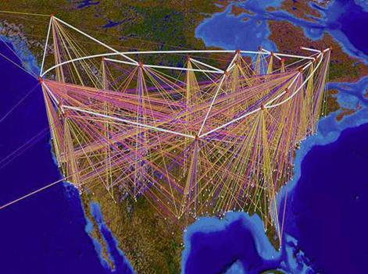
This is a (probably) outdated map of the internet

Slide 10
What happens when You Go to Danny’s FB profile?
Facebook.com domain
Your Browser
Internet
Web Server
App Server
File Server
(Images, video)
Database
1. Browser issues request to the Internet

Slide 11
What happens when I Go to Danny’s profile Page?
Facebook.com domain
Your Browser
Internet
Web Server
App Server
File Server
(Images, video)
Database
2. Request gets to Facebook domain*
*Magic handwaving here

Slide 12
What happens when I Go to Danny’s profile Page?
Facebook.com domain
Your Browser
Internet
Web Server
App Server
File Server
(Images, video)
Database
3. Web server takes your request and sends it to the application server to be handled

Slide 13
What happens when I Go to Danny’s profile Page?
Facebook.com domain
Your Browser
Internet
Web Server
App Server
File Server
(Images, video)
Database
4. App server runs custom computer code to build your requested web page and asks the database for information it needs

Slide 14
What happens when I Go to Danny’s profile Page?
Facebook.com domain
Your Browser
Internet
Web Server
App Server
File Server
(Images, video)
Database
5. App Server returns finished html page to web server

Slide 15
What happens when I Go to Danny’s profile Page?
Facebook.com domain
Your Browser
Internet
Web Server
App Server
File Server
(Images, video)
Database
6. Web Server returns finished html page to browser

Slide 16
What happens when I Go to Danny’s profile Page?
Facebook.com domain
Your Browser
Internet
Web Server
App Server
File Server
(Images, video)
Database
7. Browser receives the document from the web server, and renders it

Slide 17
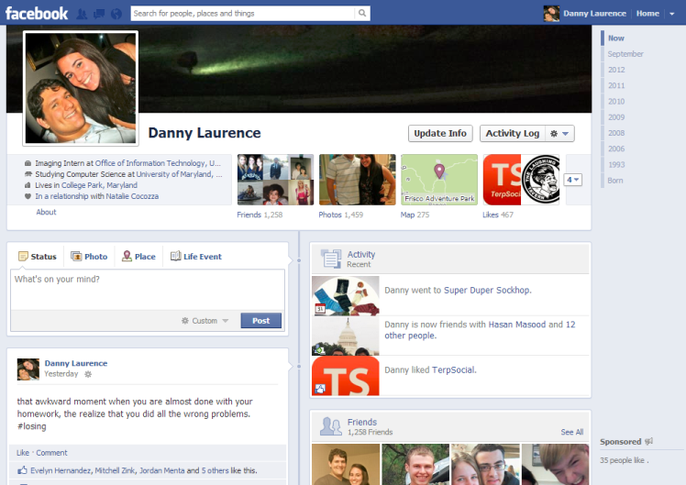
Familiar

Slide 18
What Will you have at the end of this course*?
Facebook.com domain
Your Browser
Internet
Web Server
App Server
File Server
(Images, video)
Database
*For full disclosure, they may all be on the same physical machine

Slide 19
Starting point
Let’s start at the very beginning…

Slide 20
What separates your Business from the rest?
How it is…
In 2013, the Apple App Store surpassed 1 million apps
~ 1.2 million apps on Google Play
Back in March, there were 60 Flappy Bird clones released PER DAY
So what do I do about it?
Unique content? Possible, but at this point need a Blue Ocean
The real key: Finding user needs and creating a design that fits that
Sound familiar to anything you learned in QUEST?
Source: http://www.forbes.com/sites/insertcoin/2014/03/06/over-sixty-flappy-bird-clones-hit-apples-app-store-every-single-day/

Slide 21
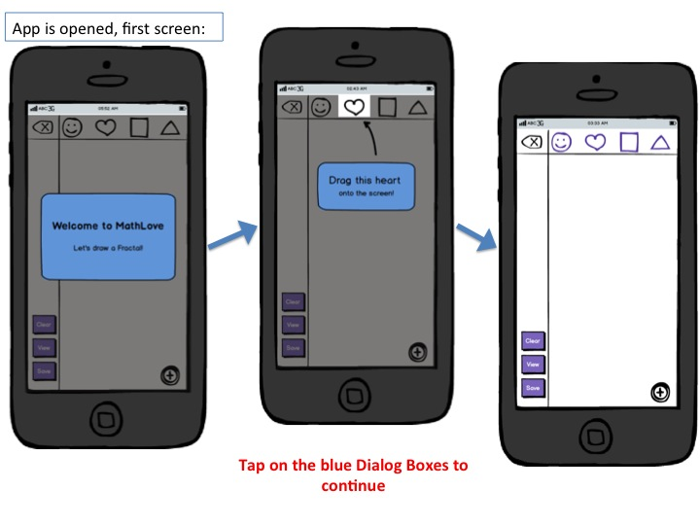
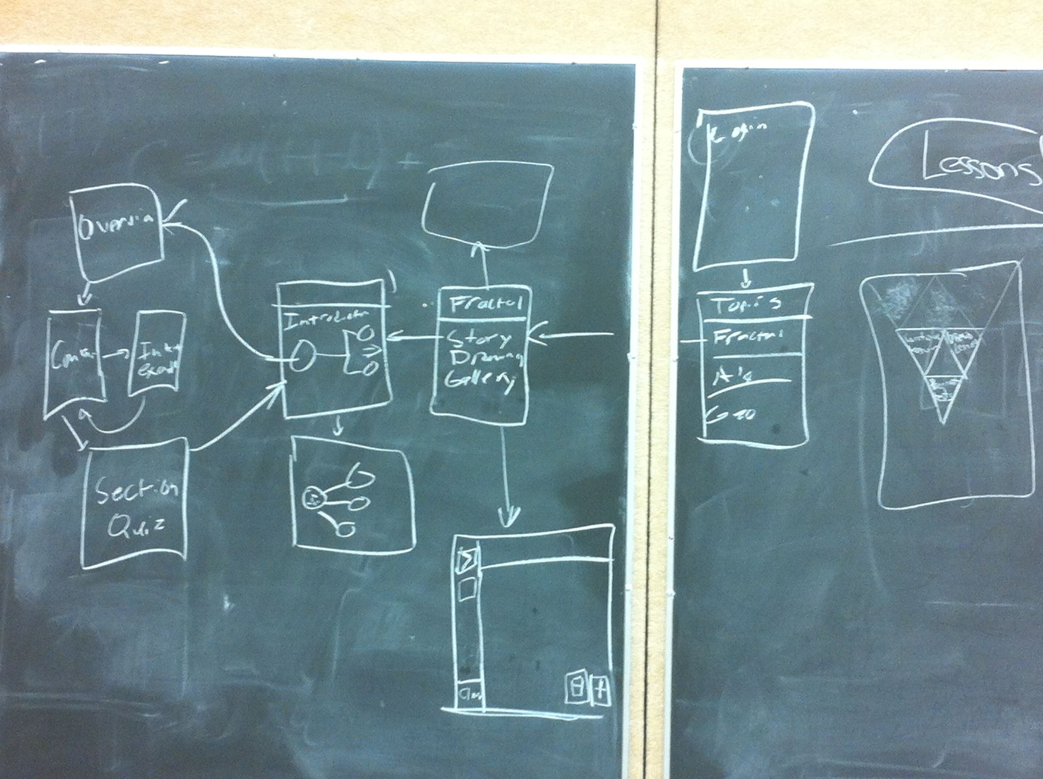
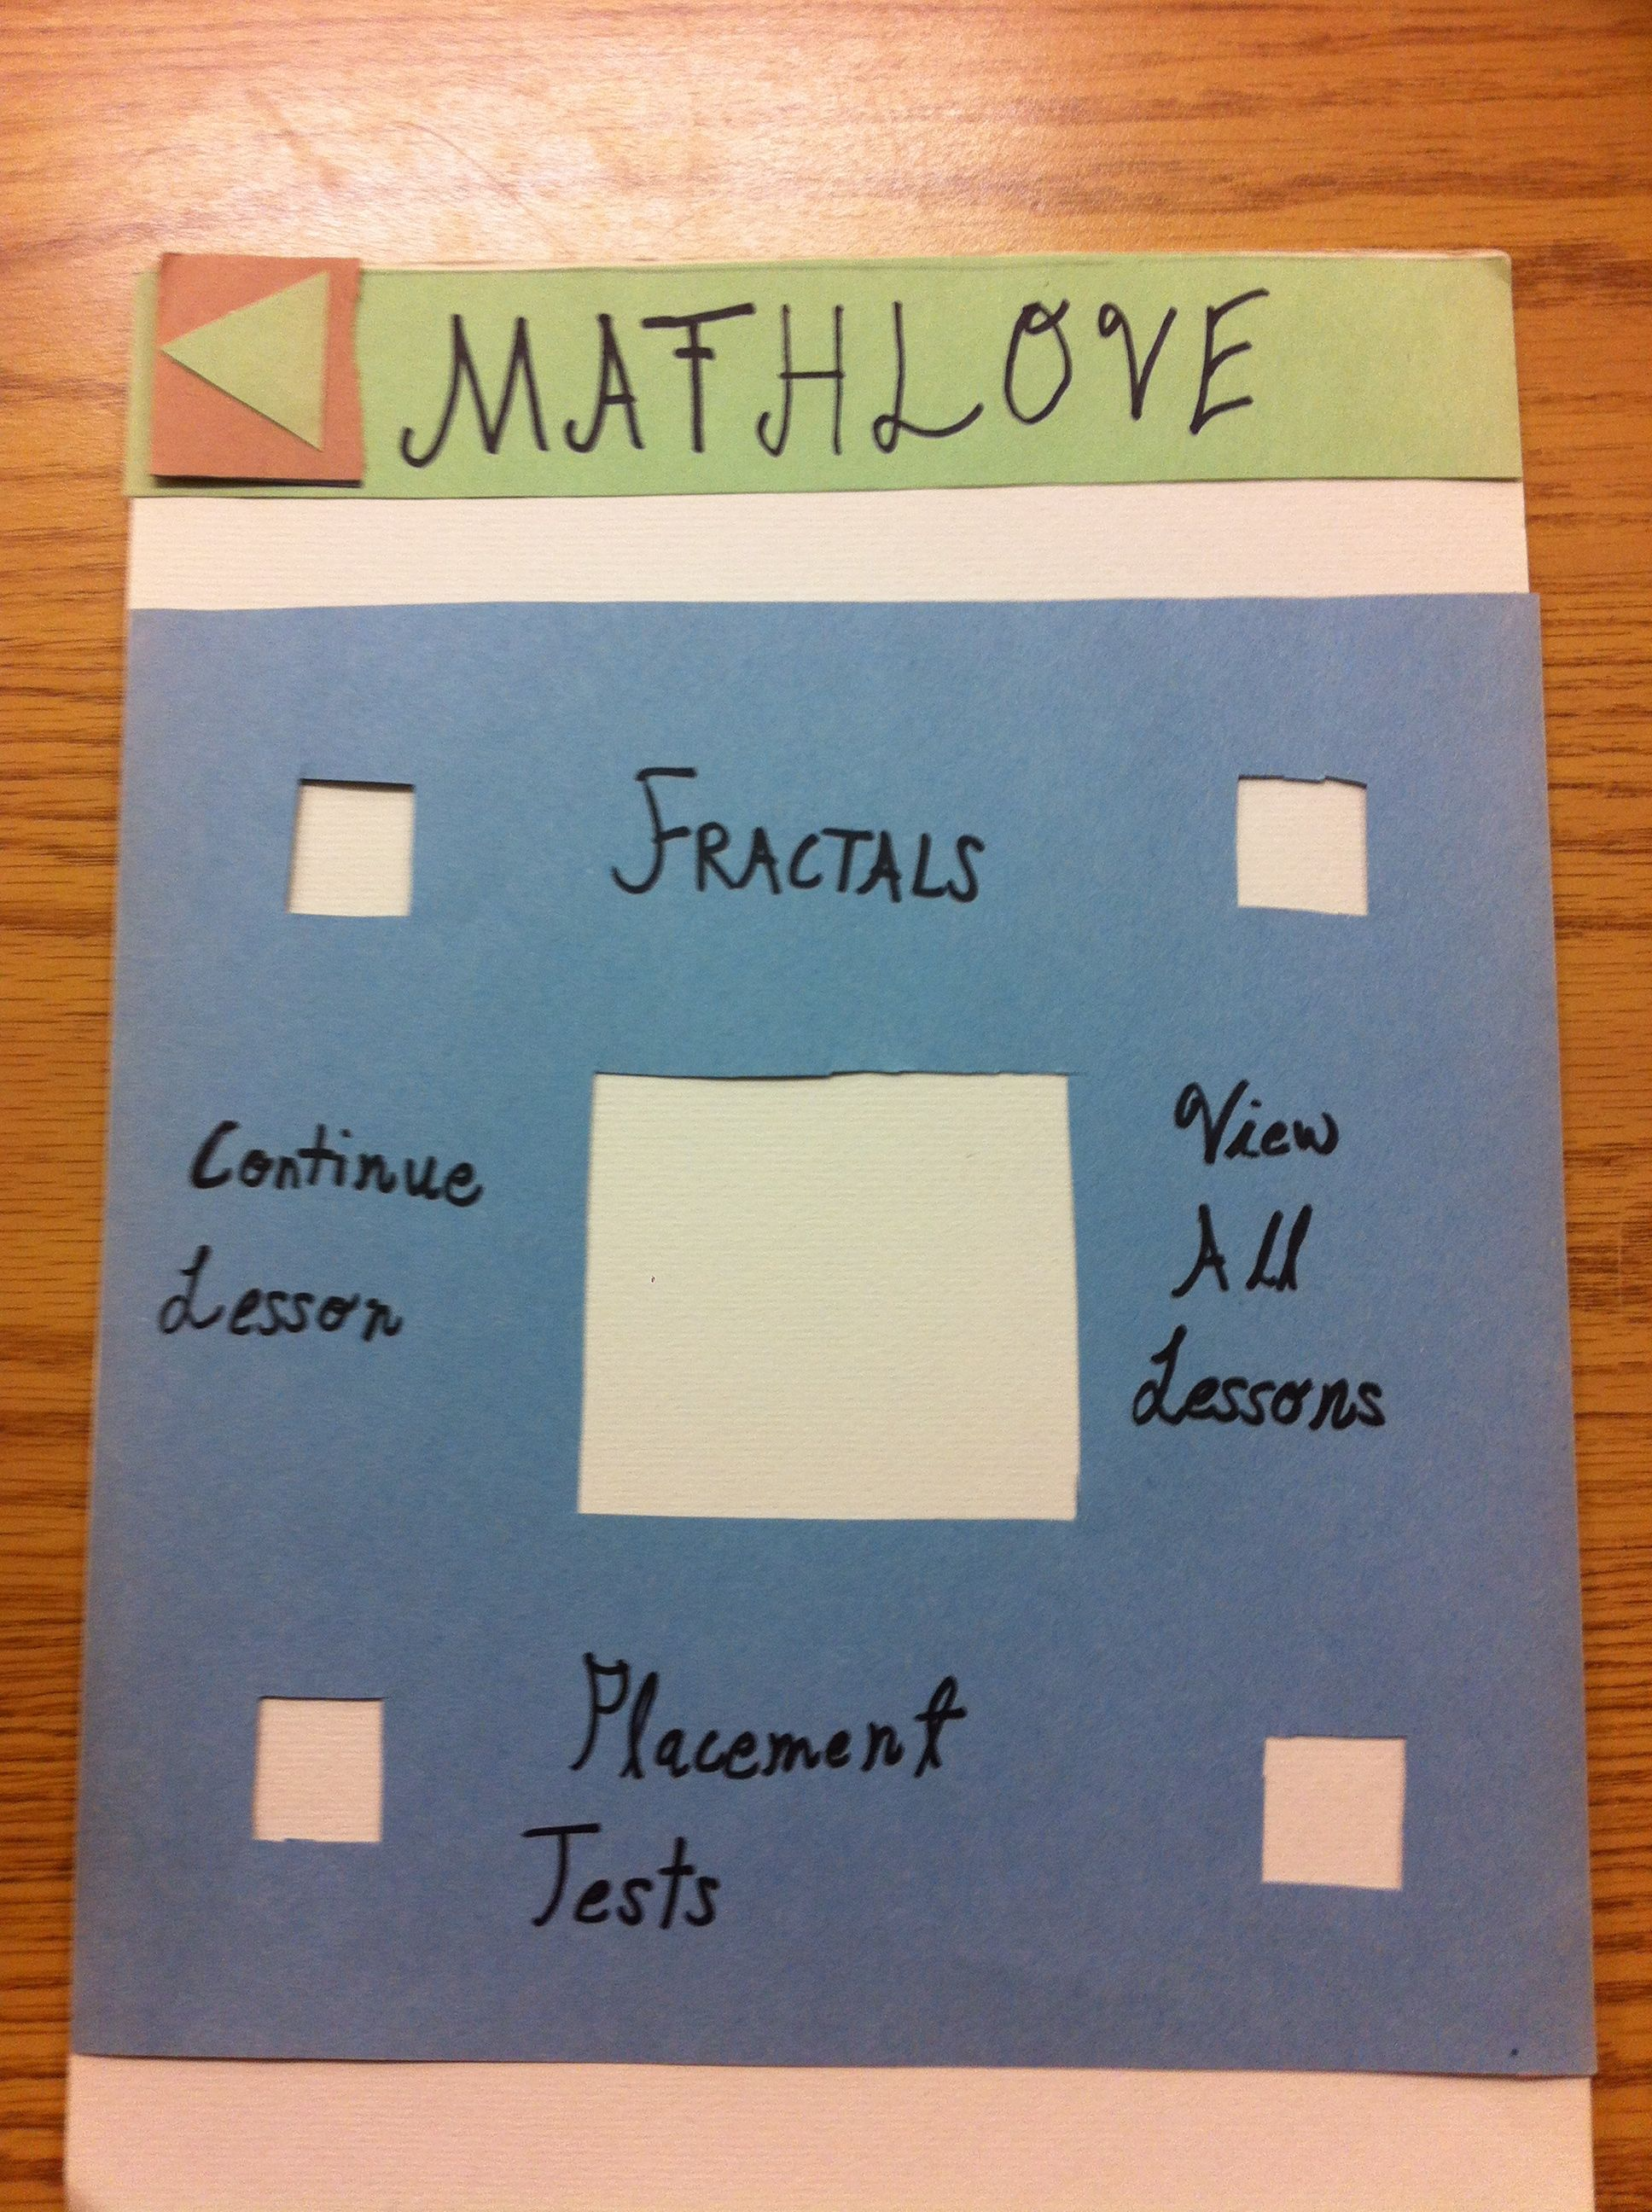
So what’s the first step?
Make prototypes!
Sound familiar?

Slide 22
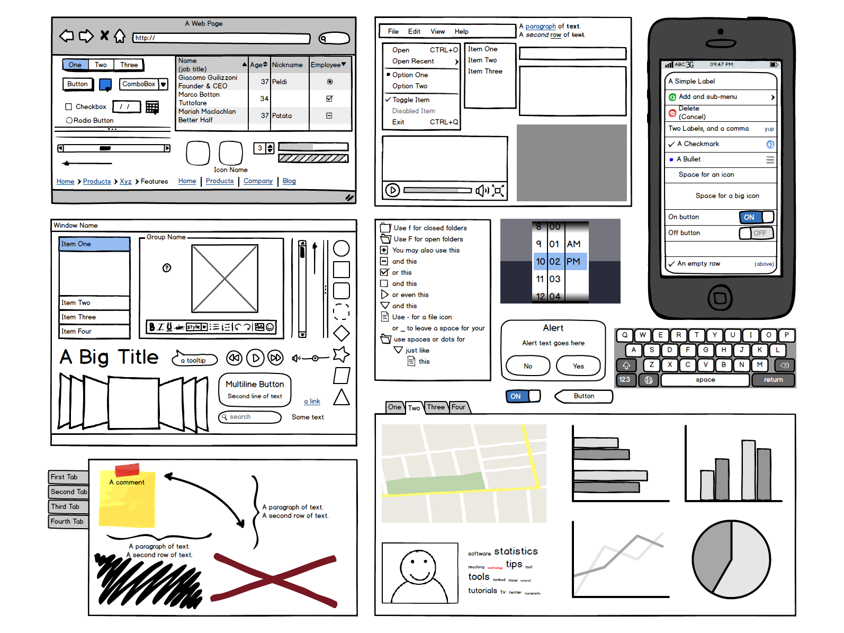
What’s a good tool? Balsamiq

Slide 23
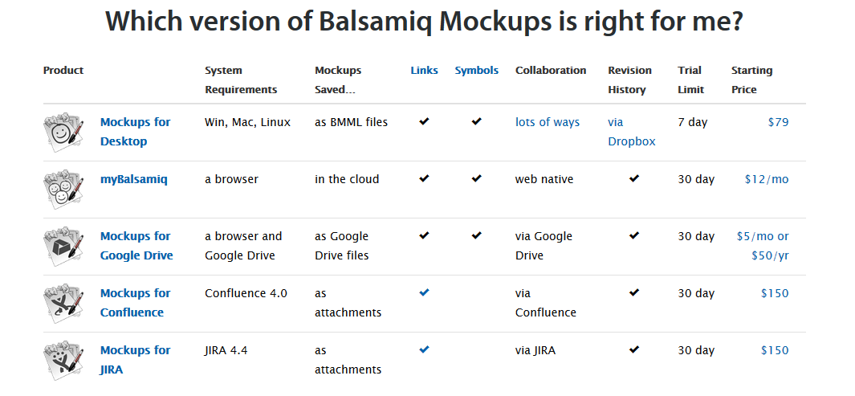
Benefits of Balsamiq

Slide 24
Presentation Layer
HTML & CSS

Slide 25
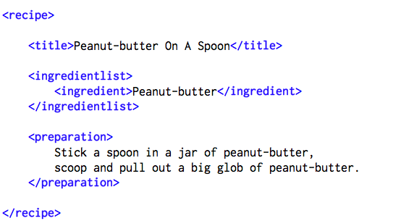
<Explanation>
Facebook is a website, written in HTML
HTML → Hyper Text Mark Up Language
What is a mark up language?
Are there others?
Notes:
Mark-up language
Just a way to syntactically distinguish text
There are many, LaTeX is a popular research paper formatting tool

Slide 26
<First Try>
<html>
<head>
<title> Danny’s Academic Website</title>
</head>
<body>
<p> Hello World! </p>
</body>
</html>
Is this exact spacing necessary? Not necessary, but highly recommended for readability.
Notes:
HTML tag declares html document
Head tag encompasses header
Loaded before the body is
Used to define things about the HTML page
Title
Style
Used to load things earlier than the page
This is why images, which are very large files, can be loaded as fast as text
Body tag encompasses body
The actual content of the page. This is where paragraphs, images, videos, etc. are "laid out"
White Space is the best

Slide 27
<A closer look>
<html>
<head>
<title> Danny’s Academic Website</title>
</head>
<body>
<p> Hello World! </p>
</body>
</html>
Set the title of the page to the following text
Do this first
The following
text is going to
be HTML
Create a paragraph and put the following text in it
The "body" of the page
These tags allow you, the developers, to format and tailor your pages exactly as you imagine them.

Slide 28
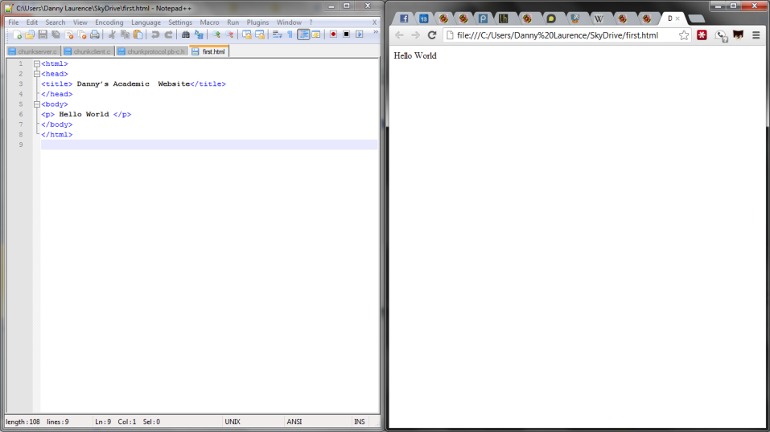
<Split Screen>
Notes:
Open the containing folder with the HTML document
Double click it, should load in default browser
Note: to edit the page, right click and select a text editor

Slide 29
<Attributes>
What if I want my text to be blue?
Must use style attribute:
<p style="color:blue;"> Hello World! </p>
How many attributes are there?
HTML5 Global Attribute Table:
Changes "style" attribute to contain "color:blue"
Attribute | Description
accesskey | Specifies a shortcut key to activate/focus an element
class | Specifies one or more classnames for an element (refers to a class in a style sheet)
contenteditableNew | Specifies whether the content of an element is editable or not
contextmenuNew | Specifies a context menu for an element. The context menu appears when a user right-clicks on the element
dir | Specifies the text direction for the content in an element
draggableNew | Specifies whether an element is draggable or not
dropzoneNew | Specifies whether the dragged data is copied, moved, or linked, when dropped
hiddenNew | Specifies that an element is not yet, or is no longer, relevant
id | Specifies a unique id for an element
lang | Specifies the language of the element's content
spellcheckNew | Specifies whether the element is to have its spelling and grammar checked or not
style | Specifies an inline CSS style for an element
tabindex | Specifies the tabbing order of an element
title | Specifies extra information about an elemen
Notes:
Attributes are ways to modify the tag to fit your design
There are a lot of them

Slide 30
<A Step Further>
What if I wanted EVERYTHING with the <p> tag to be colored blue? How could I accomplish this?
<html>
<head>
<title> Danny’s Academic Website</title>
</head>
<body>
<p> Hello World! </p> <p> This is the next paragraph </p>
<p> I’d hate to have to style everyone </p>
<p> What am I, a hair dresser? </p>
</body>
</html>
Notes:
Just add more <p>’s

Slide 31
<Naïve>
<html>
<head>
<title> Danny’s Academic Website</title>
</head>
<body>
<p style="color:blue;"> Hello World! </p> <p style="color:blue;"> This is the next paragraph </p>
<p style="color:blue;"> Hate to style everyone… </p>
<p style="color:blue;"> What am I, a hair dresser? </p>
</body>
</html>
Notes:
Hope that someone doesn’t answer with CSS
In this, it’s naïve because I have to individually edit each <p>

Slide 32
<Wouldn’t it be nice…>
If we could have one statement to define how all <p> tags behave?
Introducing…. Cascading Style Sheet (or CSS)
Notes:
NICE transition, if I do say so myself.

Slide 33
<Improved Example>
<html>
<head>
<title> Danny’s Academic Website</title>
<link rel="stylesheet" type="text/css" href="/myCSS.css" />
</head>
<body>
<p> Hello World! </p> <p> This is the next paragraph </p>
<p> Hate to style everyone… </p>
<p> What am I, a hair dresser? </p>
</body>
</html>
This link is a stylesheet
This link is a text format
This is the location the CSS file
Notes:
Have them just copy this down

Slide 34
< myCSS.css>
Create a new file in the same folder (File→ new)
Save as myCSS.css with the following text:
p {
color: blue;
}
Define a rule set for the <p> tag
Define a rule to make all <p>’s blue
…it’s really that easy
http://www.w3schools.com/cssref/default.asp

Slide 35
<External CSS>
Currently, we are using an internal CSS
No reason why we couldn’t use someone else's:
Holtz and Merck have created a CSS for you
Use it as reference
Use it as your style
To use it, change: href="http://www.geol.umd.edu/sgc/sgcstyle.css"

Slide 36
<Links>
<html>
<head>
<title> Danny’s Academic Website</title>
<link rel="stylesheet" type="text/css" href="/myCSS.css" />
</head>
<body>
<p><a href="www.google.com"> Hello World! </a></p>
</body>
</html>
Notes:
Important note: this is how to link to other places in your website

Slide 37
<Lists>
Ordered List: <ol> … </ol>
Unordered List: <ul> … </ol>
In either case, use a List Item <li> to put in a "point"
<body>
<h1> Scholars Assignments: </h1>
<ul>
<li><a href="/assign1.html"> Assign1</a></li>
<li><a href="/assign2.html"> Assign2 </a></li>
<li><a href="/assign3.html"> Assign3 </a></li>
<ul>
</body>
Notes:
Picked a helpful example

Slide 38
<Images>
Some webpages have images…
<body>
<img src= "/yourPicture.jpg" alt= "A picture of me" height="42" width="42">
</body>
Name of picture in current folder
The alternative text
Height and Width (default is pixels, could be percentage)
Notes:
Realize that the src is just where the picture is located, either on the server or the internet

Slide 39

<Who’s lost>

Slide 40
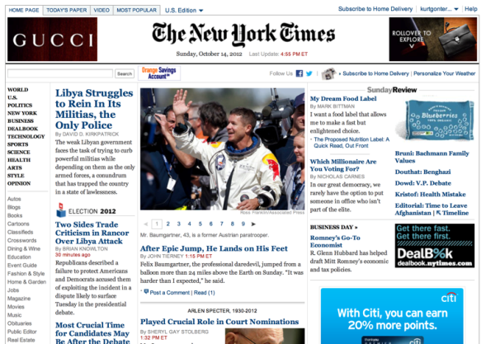
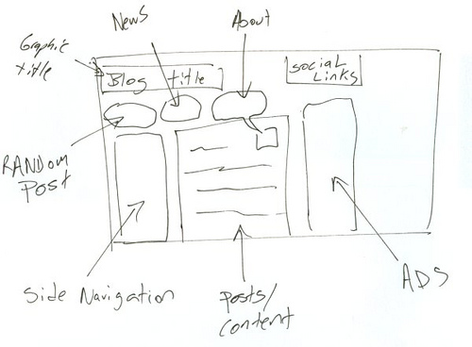
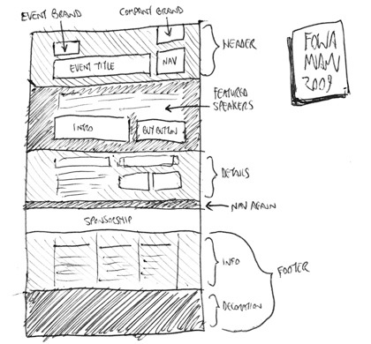
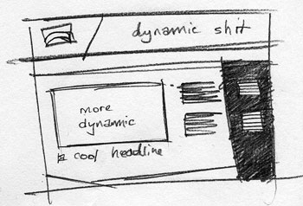
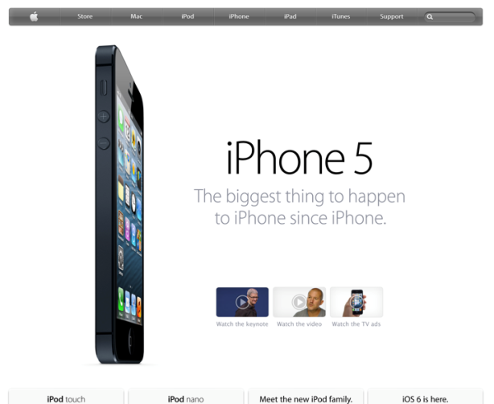
<The tag is the limit>
HTML, images, and style sheets
http://www.csszengarden.com/
Notes:
Use good design sense
Draw it out!
Get insipered

Slide 41
Now you try!
Mozilla

Slide 42
Check out the internals of your favorite site
Develepor tools (Firefox or Chrome)
https://goggles.webmaker.org/en-US

Slide 43
Try out writing your own html
https://thimble.webmaker.org/en-US
http://jsfiddle.net/

Slide 44
Lunch!

Slide 45
Team Time!

Slide 46
What To Discuss?
Schedules
Contact Info
App Ideas
Whatever else you want

Slide 47
How To work Together
Using Source Control

Slide 48

Use Case
The whole point is to share files across machines
What happens if 2 people edit the same document and they save at different times?
What gets included and what doesn’t?

Slide 49
Version Control!
Don’t share the files themselves, share their HISTORY
Diff: The incremental changes to files between the last time you updated
This way, the system can be sure that you’re overwriting a line because you meant to instead of by accident!

Slide 50
Visual illustration : Initial State
Web Server
Commit 513
Programmer 1
Programmer 2

Slide 51
Visual illustration : Starting State
Web Server
Commit 513
Clone
Clone
Programmer 1
Programmer 2
Commit 513
Commit 513

Slide 52
Visual illustration : Each Makes Changes
Web Server
Commit 513
Programmer 1
Programmer 2
Commit 777
Commit 631

Slide 53
Visual illustration : Prog. 2 changes server
Web Server
Commit 631
Push
Programmer 1
Programmer 2
Commit 777
Commit 631

Slide 54
Visual illustration : Prog. 1 changes server
Web Server
Commit 631
Push Fails
Programmer 1
Programmer 2
Commit 777
Commit 631

Slide 55
Visual illustration : Prog. 1 Pulls Changes
Web Server
Commit 631
Pull
Programmer 1
Programmer 2
Commit 777
Commit 631
Merge Conflict

Slide 56
Visual illustration : Prog. 1 Merges Changes
Web Server
Commit 631
Programmer 1
Programmer 2
Commit 777
Commit 631

Slide 57
Visual illustration : Prog. 1 Pushes Changes
Web Server
Commit 777
Programmer 1
Programmer 2
Commit 777
Commit 631

Slide 58

Now let’s get you Acquainted with git!

Slide 59
If you are super interested…
https://stackoverflow.com/questions/315911/git-for-beginners-the-definitive-practical-guide

Slide 60
GitHub
Git is a version control system
GitHub is a place people can share open source projects using Git
https://github.com

Slide 61
Your development Environment

Slide 62


Two places your code will Execute
Local Testing
Production

Slide 63
xampp
Free server that runs on your computer
Not accessible to the outside world
Lets you host
static files (images)
dynamic files (your code – we’ll get to that next week)
Data – mysql database
Use this to see how your code looks and executes as you work

Slide 64
Amazon Web services
You’re going into the cloud! (We’ll explain that in a few weeks)
You’ll be in the free tier – publically accessible
Show this off to friend and family when it’s done
Send code here when it’s in a working and stable condition
The instructors will help you get your code out here
WARNING: Since it is publically accessible, be careful about what data you store since there is a chance it could be hacked. No real names, addresses, credit cards, etc until we give you advice

Slide 65
User Interface Design Theory
Yea, it’s a mouthful

Slide 66
Determine user’s skill levels
“Know thy user”
Age, gender, physical and cognitive abilities, education, cultural or ethnic background, training, motivation, goals and personality
Design goals based on skill level
Novice or first-time users
Knowledgeable intermittent users
Expert frequent users
Multi-layer designs

Slide 67
The 8 golden rules of interface design
Strive for consistency
Cater to universal usability
Offer informative feedback
Design dialogs to yield closure
Prevent errors
Permit easy reversal of actions
Support internal locus of control
Reduce short term memory load
Notes:
Issues:
1. Doesn’t cover everything (i.e. font, color, performance)
2. Very subjective

Slide 68
Prevent errors
Make error messages specific, positive in tone, and constructive
Mistakes and slips (Norman, 1983)
Correct actions
Gray out inappropriate actions
Selection rather than freestyle typing
Automatic completion
Complete sequences
Single abstract commands
Macros and subroutines

Slide 69

Usability Testing and Laboratories

Slide 70
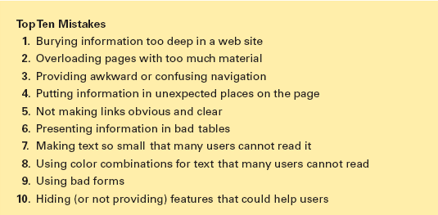
Web page design
The top ten mistakes of web-based presentation of information (Tullis)

Slide 71
Responsive Design
http://www.newsweek.com/
http://www.ndbancgroup.com/

Slide 72
How TO: User Interface

Slide 73
Color
https://kuler.adobe.com/create/color-wheel/

Slide 74
Bootstrap
http://getbootstrap.com/

